Slide 1

Project Title - Seasonal Agriculture Performance Analysis
[SHIVA KESHAV THATIPELLI
College Name- SR UNIVERSITY ]
AICTE STU ID : STU69c0042c3ccc21774191660

Slide 2

PROBLEM STATEMENT
Agricultural activities are influenced by seasonal variations in environmental conditions, farming practices, resource availability and market conditions. As a result, agricultural performance may differ from one season to another. However, raw agricultural data does not clearly explain how agricultural performance changes across seasons or what patterns can be observed in different seasonal conditions. The problem is to analyze the given agricultural dataset and investigate seasonal differences in agricultural performance by identifying meaningful patterns, trends, relationships and variations within the available data.

Slide 3
Project Description
Analyzes agricultural performance across different states, crops, and seasons.
Studies crop yield, rainfall, temperature, soil moisture, sunlight, water usage, and profit.
Cleans the dataset by handling missing values and duplicate records.
Uses Python, Pandas, and data visualization for analysis.
Identifies patterns, trends, and relationships in agricultural data.
Compares seasonal, state-wise, and crop-wise performance.
The project focuses on Data Analytics only, with no Machine Learning or dashboard development.

Slide 4

WHO ARE THE END USERS?
Farmers – to understand better-performing crops and seasons.
Agricultural officers – to study agricultural performance across regions.
Researchers – to analyze farming and environmental patterns.
Agricultural businesses – to understand crop yield and profitability.
Students and analysts – to study agricultural data and trends.

Slide 5

Technology Used
Technology Used
Python – Data analysis and processing
Pandas – Data cleaning and manipulation
NumPy – Numerical calculations
Matplotlib – Data visualization
Seaborn – Statistical visualization
Jupyter Notebook – Project development and analysis
CSV Dataset – Source of agricultural data

Slide 6
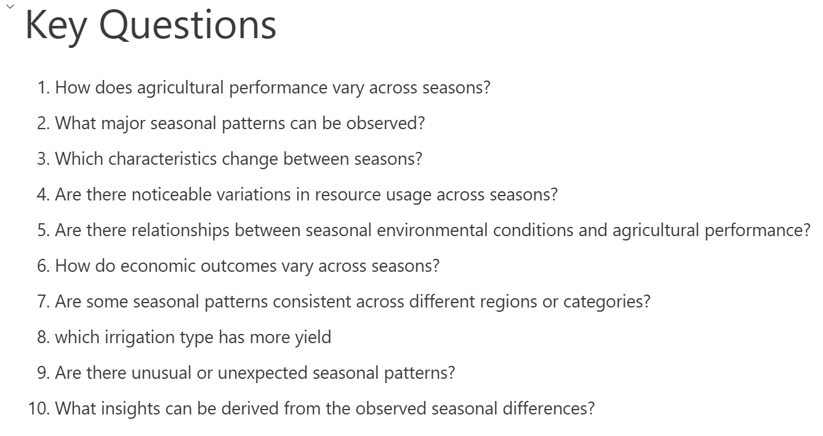
RESULTS

Slide 7
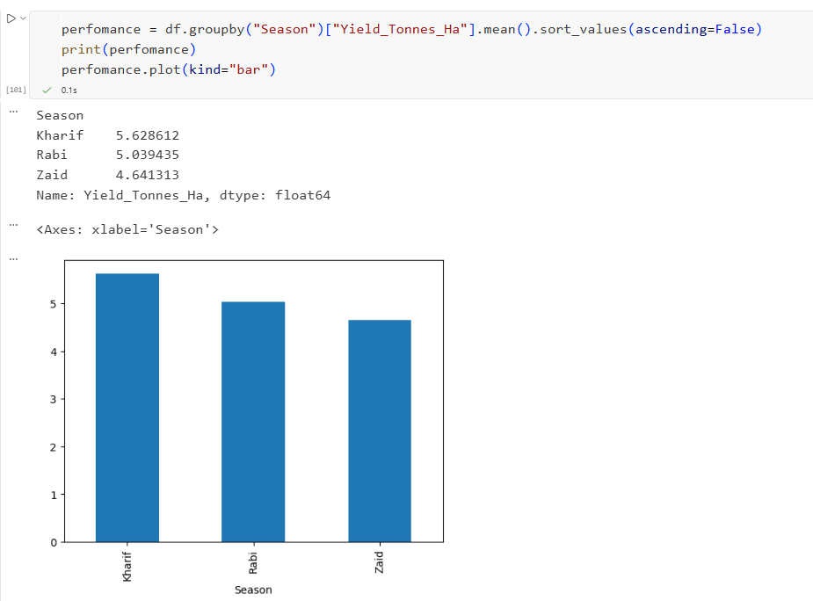
RESULTS
[Add screen shots of your code ]

Slide 8
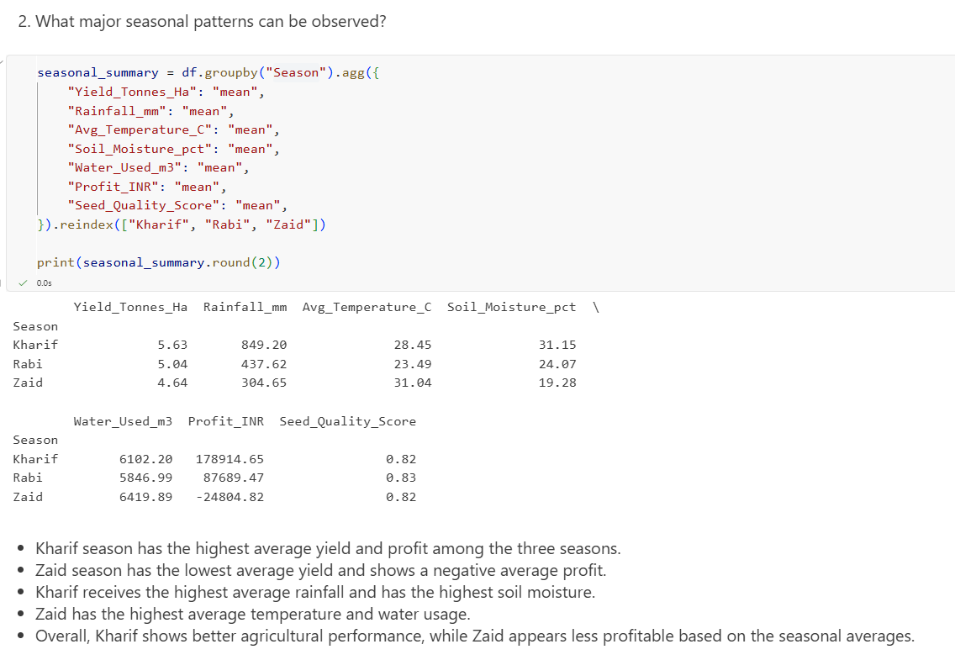
RESULTS
[Add screen shots of your code ]

Slide 9
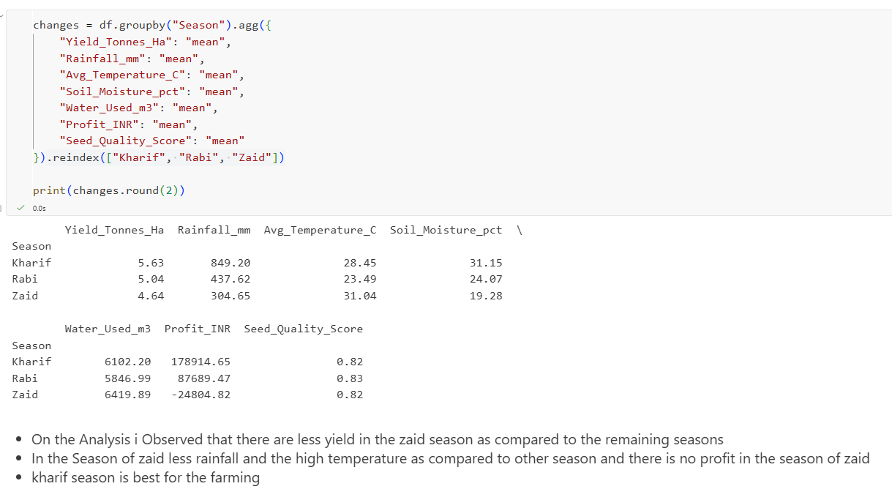
RESULTS
[Add screen shots of your code ]

Slide 10
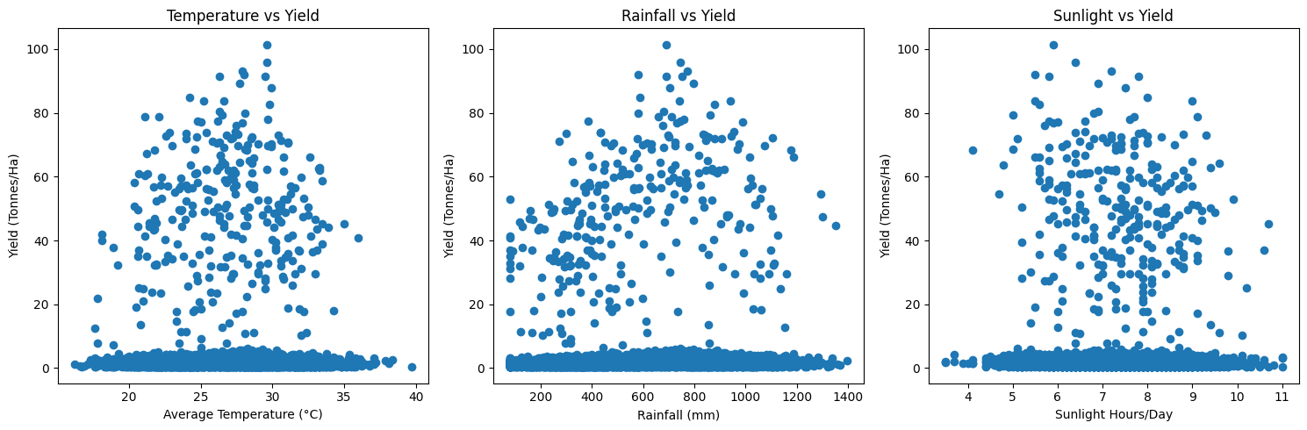
RESULTS

Slide 11
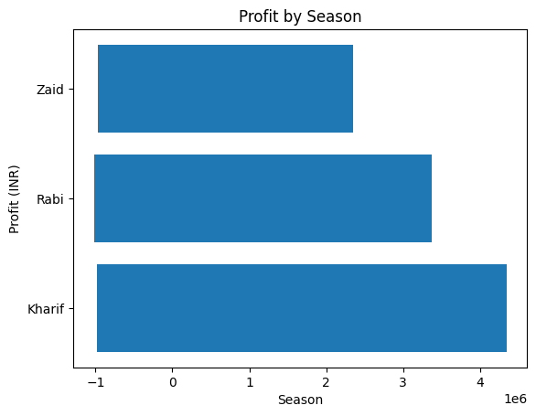
RESULTS

Slide 12
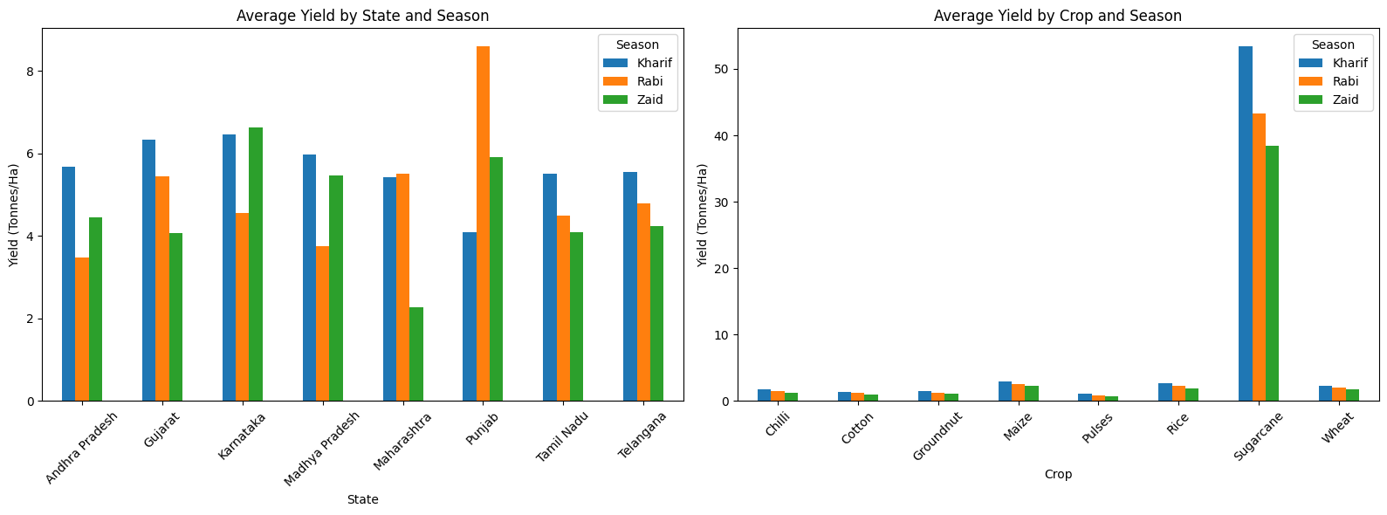
RESULTS

Slide 13
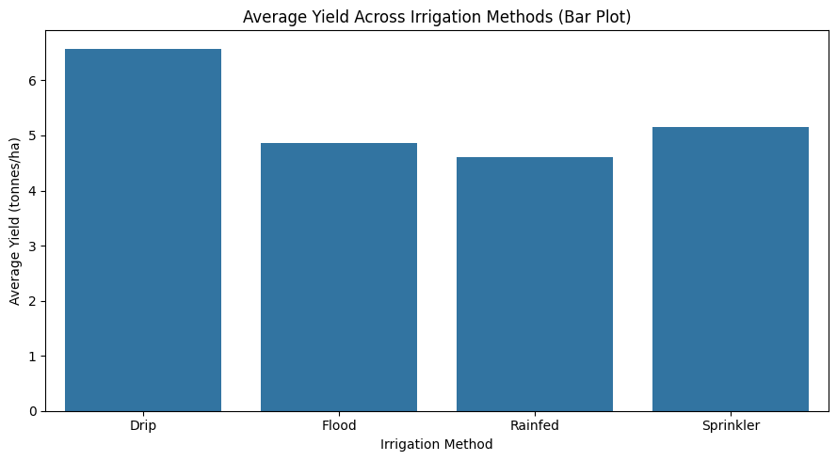
RESULTS

Slide 14
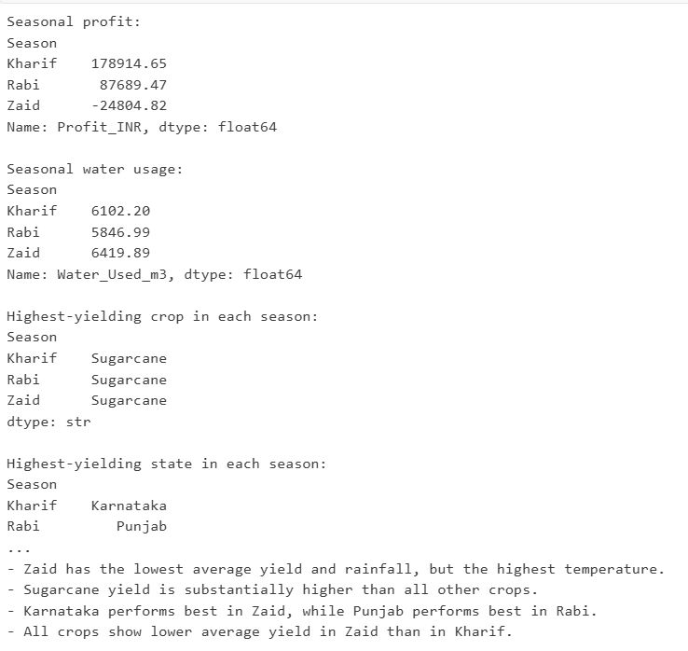
RESULTS

Slide 15
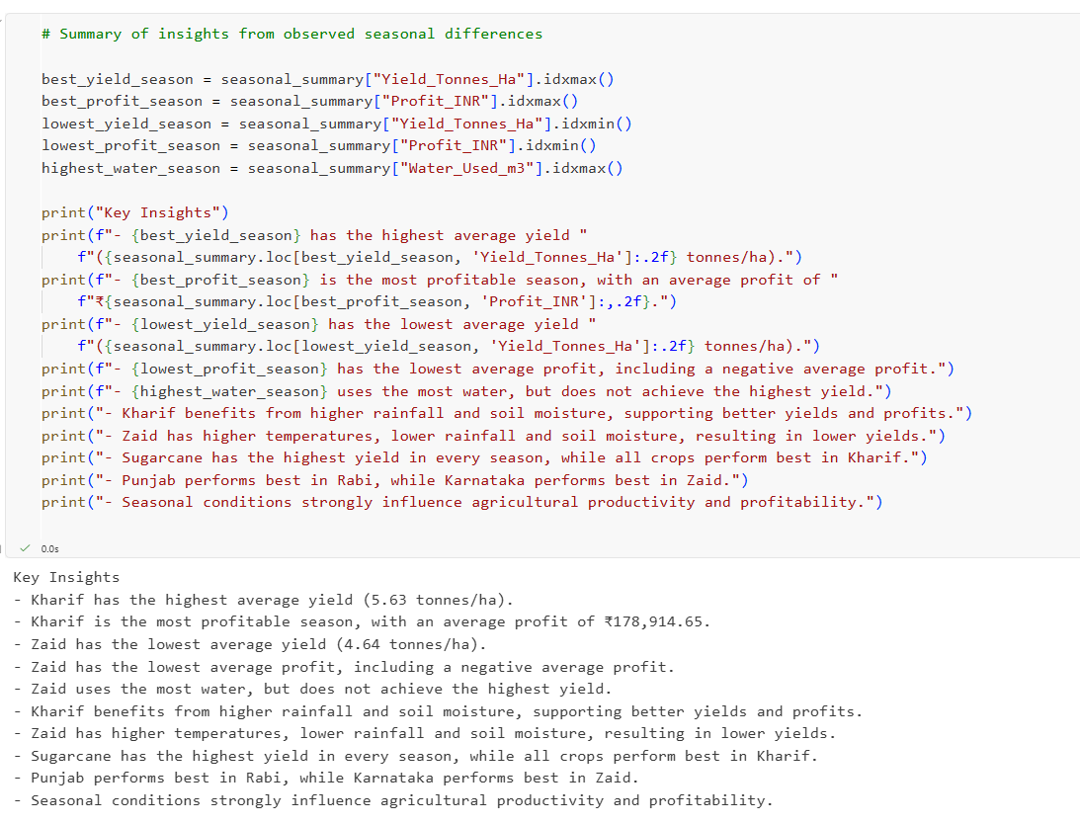
RESULTS

Slide 16
Future scope
Future Scope means what can be added or improved in the project later.
For your project, you can write:
Future Scope
Add Machine Learning to predict crop yield.
Develop an interactive dashboard for easier data exploration.
Include more states, crops, and years for better analysis.
Add real-time weather and agricultural data.
Build a system to help farmers make better crop and resource decisions.

Slide 17
GitHub Link
https://github.com/shivakeshav046-ui/Agriculture-seasonal-perfomance-analysis/tree/main

Slide 18

VOIS Course completion certificate -
Course name- Data Visualization

Slide 19
Thank you
SHIVA KESHAV THATIPELLI
AICTE STU ID : STU69c0042c3ccc21774191660
.

